Slide 1
Software Development 3
OOD Review

Slide 2
Design Approaches
2 Main Approaches
Functional Oriented Design:
Starting point:
What will the system do?
Object Oriented Design:
Starting point:
What data will be stored in the system?

Slide 3
What is a Class?
“A class is a blueprint or template that defines the variables and methods common to all objects of a certain kind”
It specifies what data needs to be stored for an object, and how the object needs to be designed.
Every object which is created using this class will be the same

Slide 4
Class Example
You are creating a template for a car. What do all cars have/need?
Body
Transmission
Doors

Slide 5
What is an Object?
“An object is an instance of a class”
“Instance” or “instantiated” means a built or constructed version of what is set out in the plan (class)
Car companies follow a template (class) for how their car is designed.
Each car (Object) is an instance of that template….

Slide 6
What is an Object?
Looking at an object from more of a programming point of view we can alter the definition as follows:
“An object is an instance of a class with a group of attributes and related methods”
You can only use the previous class to build a Car object. Obviously, it cannot be used for motorcycles/bicycles/ etc.

Slide 7
What is an Object?
From before:
  “An object is an instance of a class with a group of attributes and related methods”
So there are 2 parts to an object
  - the data the object stores
  - the methods the object has
Using our previous car example…

Slide 8
Data the object stores:
Type of Body the car has
Number of Doors the car has
Transmission type
We can think of this like a database – each of these attributes are a column in the database.

Slide 9
Our Car Objects as rows in a Database….
Body | Doors | Transmission
Hatchback | 3 | Manual
Saloon | 5 | Manual
Hatchback | 5 | Manual
Each Column header shows our attributes – data that must be stored for each object
Each Row is an Object, a Car that has been created (a real thing!)
When we create a database table OR a class, we are specifying that our Rows/Objects have this data.

Slide 10
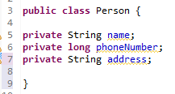
Person Class
This code creates a Person class.
It contains the template for creating every person – they all have a name, a phone number, and an address…

Slide 11
Visibility of methods
Visibility | Class | Package | Subclass | World
Public | Y | Y | Y | Y
Protected | Y | Y | Y | N
Package (no modifier) | Y | Y | N | N
Private | Y | N | N | N
Detailed example of this will be shown later

Slide 12


Methods
Return Types:
void (nothing to return)
String
int
long
float
Boolean
Object
etc….

Slide 13
Creating an Object
When constructing a house the builder takes the blueprint (class in OOD terms) and uses it to order e.g. blocks and sand. Using the blocks and sand the house is constructed.
When a JAVA program starts the JVM performs the equivalent of ordering blocks and sand i.e. it reserves memory space in the RAM of the computer for the object. The memory is reserved on “The Heap”.
Once the memory space has been reserved a special method called a constructor sets the initial values of the attributes in reserved memory space.

Slide 14

Constructors
Special type of method
Same name as the class
No return type
Implicitly returns instance of the class
Don’t have to declare a Constructor – if none created, a default Constructor is created. It’s the same as creating a Constructor with no parameters, and setting instance variables as default values

Slide 15
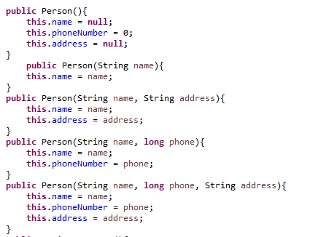

Overloading
We can however create multiple constructors (or any method) which have different number of, or types of parameters:

Slide 16
Creating an Object
Constructors are used to create objects
Person p1 = new Person();
Call to the constructor
New keyword – create new object of type…..
Reference name of new Object (always unique)
Class type of Object

Slide 17
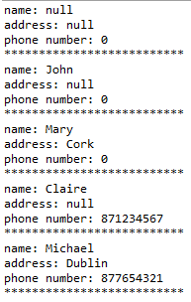
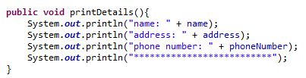
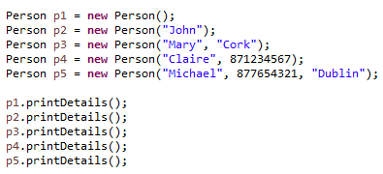
Calling Methods
We can add a method called printDetails to our Person class as follows:
Which allows us to easily output the details for each person….

Slide 18
Calling Methods
As you’ve seen, each method in the class is useable by any object created using the class ‘template’
We created 5 people objects p1, p2, p3, p4, p5
When printDetails called for these objects, it uses the details from that object:
p1.printDetails() will print the details for p1. It only has access to the information for that specific object.

Slide 19
Exercises
Create a class Car
Number of doors
Type of transmission
Body type
Create 2 constructors: one empty, one with all three parameters

Slide 20
Encapsulation
Name | Address | Phone Number
John | null | 0
Mary | Cork | 0
Claire | null | 871234567
Michael | Dublin | 877654321
Suppose we need to add an address or phone number for John, Mary, or Claire?
What if Michael changes his phone and moves network?
We need methods to allow us to read or change the data.

Slide 21
Getters and Setters
All instance variables are generally set to private. This ensures they are only visible within the class, and if external classes need to make changes, they must know the underlying structure.
Previously we printed details of the object using a printDetails method within the class. System.out.println(“Name: “ + name)
We cannot access these details in another class in this manner if they are set to private.

Slide 22
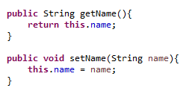
Getters and Setters
Encapsulation uses methods called getters and setters to get (read) and set (update/change) details.
We return the name (which is a String) of the Person
object. No information is needed to access the name,
so no parameters are passed in.
We change the details (for example Mary got
married) by passing in a String, but as we are
not looking for information, nothing needs to
be returned – void return type.

Slide 23
Getters and Setters
The getters and Setters are named so that the code is understandable to everyone
Each instance variable will have a getMethod and a setMethod
They are not mandatory (sometimes they’re not needed as data won’t be changed), however it is best practice to include them.

Slide 24
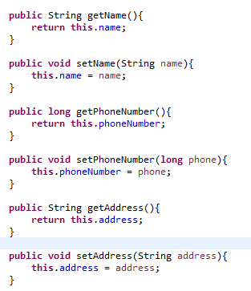
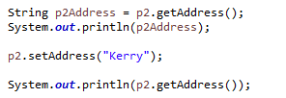

Getters and Setters continued
Either of these work
Output:

Slide 25
Exercise
Using the class Car
Add getters and setters for the attributes
Create a printDetails() method
Create a "tester" class to create 3 Car objects using both constructors (6 in total)
Using the getters and setters, add information to the Cars created with empty constructor
Print details for all cars

Slide 26
Explaining what I mean….
Car c1 = new Car();
C1.setDoors(5);
C1.setTransmission("Manual");
C1.setBody("Saloon");
System.out.println("Car 1: "+ c1.getDoors() + " " + c1.getTransmission() + " " + c1.getBody());
Car c2 = new Car("Hatchback", "Manual" , 5);
C2.printDetails();

Slide 27
Visibility in detail
We saw this visibility table earlier:
Visibility | Class | Package | Subclass | World
Public | Y | Y | Y | Y
Protected | Y | Y | Y | N
Package (no modifier) | Y | Y | N | N
Private | Y | N | N | N

Slide 28
Visibility
Public variables and methods can be seen by any code – any class, any package etc. This is not a secure option for variables!
Getters and Setters are public to allow access to private instance variables
However they also allow access to protected/package (no modifier) variables depending on where they are being accessed from….

Slide 29
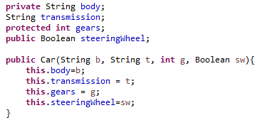


Visibility

Slide 30


Visibility

Slide 31
Visibility
The only visibility type that caused problems here was private. Why??
The classes are in the same package: all other visibility types work in the same package!
Visibility | Class | Package | Subclass | World
Public | Y | Y | Y | Y
Protected | Y | Y | Y | N
Package (no modifier) | Y | Y | N | N
Private | Y | N | N | N

Slide 32
Imagine….
Imagine you are in charge of writing the software for a local bank
They want the most basic function possible
People need to:
  Open an account (they can open an account without lodging money)
  Lodge money
  Withdraw money
  Get their balance

Slide 33
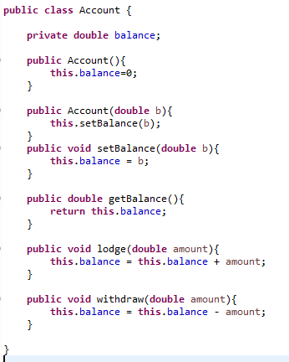
Simple Bank Account

Slide 34
Simple Bank Account
This is bad coding practice. We should be using our setBalance.
I’ll show proper coding practice in a separate file, but for now we’ll keep it simple!

Slide 35
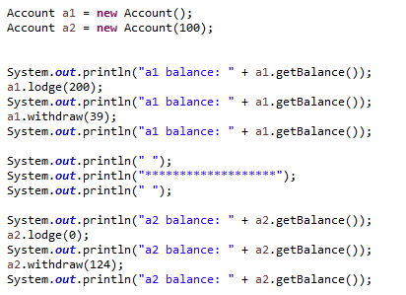
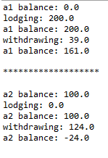
Testing….

Slide 36
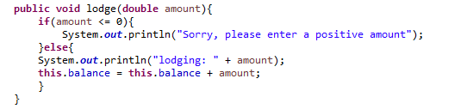
Error Checking Lodging
Possible Problems?
  Lodging 0 or minus amounts:

Slide 37
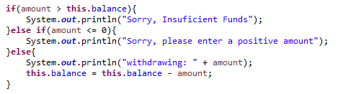
Error Checking Withdrawing
Possible Problems?
  Withdrawing more than in the account
  Withdrawing 0 or minus amounts

Slide 38
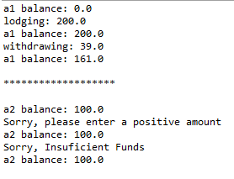
Testing….

Slide 39
Exercise
Create a basic bank account class like we just saw
Name
Address
Balance
Phone Number
Getters and Setters
Error Checking
3 Overloading Constructors
Lodge and withdraw methods to add/take from the balance

Slide 40
Variables and Parameters
The “attributes” we spoke of earlier are instance variables- they can be seen by all methods in the class.
Parameters are variables passed into the method, but they have local scope: they are only seen inside the method!
‘n’ cannot be used anywhere in our code, as it only applies inside the setName method.
Here it is used to change the value of the field variable ‘name’, but once we exit setName, ‘n’ no longer exists.

Slide 41
Variable and Parameter naming
There are different conventions for naming variables
theName, theAddress, thePhoneNumber
name, address, phoneNumber
One common convention however, is all variables must start with lower case.
You may useCamelCase or use_underscore but you must useoneofthem! Otherwise theyaretoohardtoread and maybereadincorrectly

Slide 42


The ‘this’ keyword
When assigning values to the object theName = theName won’t work – it cannot differentiate between the instance variable and parameter.
‘this’ fixes that however, by explicitly stating “name of ‘this’ object is name”

Slide 43
The ‘this’ keyword
Person p1 = new Person();
p1.setName(“Peter”);
“the name of ‘this’ Person (p1) is Peter.
Eliminates confusion between instance variables and parameters.
Once assigned, “Peter” is now an instance variable of p1.

Slide 44
Different variable types
Field Variable: variables in a class, outside of methods, can be seen by all methods, do not belong to objects like instance variables
Instance Variable: like field variables, but variables belong to the instance of an object – can be unique for each object:
  p1.getName() //”John”
  p2.getName() //”Peter”
Class Variable: variable belongs to a class, but not a specific object. Often used as a counter – what ID is to be used for the next registration (uses static keyword. More on this later)

